Slide 1
SILAKOFF EVENT

Slide 6
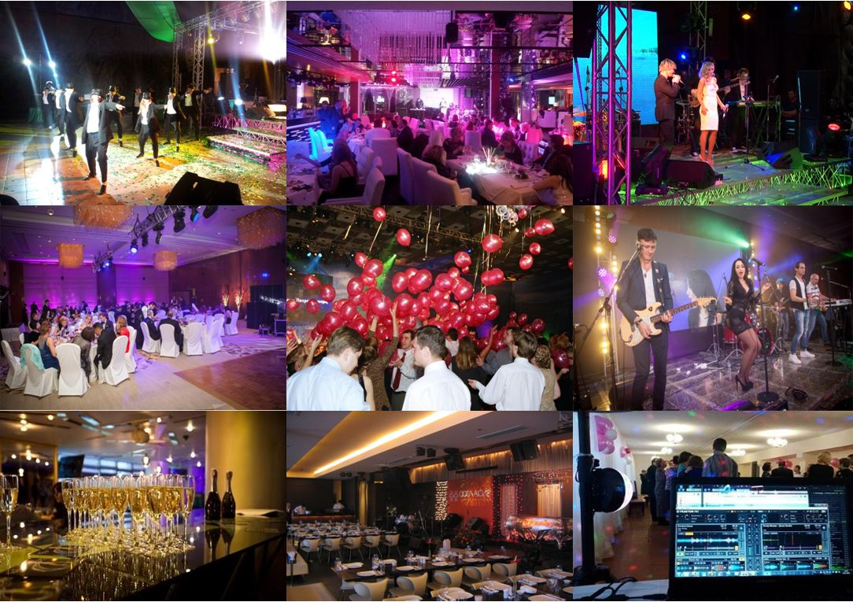

Slide 7
SILAKOFF EVENT

